Slide 1
Models, Methods and Metrics for Hardware Security
Sharada Valiveti

Slide 2
Outline
Introduction
Hardware Trojans
IP Piracy and IC Overbuilding
Reverse Engineering
Side Channel Attacks
Counterfeiting
Conclusions

Slide 3
Introduction
All implementations rely upon the hardware root of trust
Assumption:
Hardware platforms on which cryptographic algorithms and protocols are implemented are resilient to attacks
Design Considerations for any hardware:
Cost, power consumption, performance and reliability

Slide 4
Introduction
Examples of discovered vulnerabilities:
Quo Vadis Labs has reported backdoors in an integrated circuit (IC) that is used in weapons control systems, nuclear power plants, and public transportation systems [1]
Counterfeit electronics prevalent in computers, communications, automobile, control and defense systems [2][3]
Security vulnerability in hotel key-cards [5]
Researchers propose Ad hoc solutions
Developed defences cannot be compared with each other

Slide 5
Introduction - objectives
Objectives:
To systematize the knowledge for a number of important contemporary problems in hardware security and
To classify the hardware based threats, defenses and metrics to evaluate the effectiveness of developed defenses

Slide 6
Semiconductor Supply Chain [13]

Slide 7
Introduction - Threats
Hardware based threats possible from multiple points in supply chain:
Hardware Trojans
IP Piracy and IC Overbuilding
Reverse Engineering
Side channel analysis (exploiting one or more physical modalities like power consumption, timing or electromagnetic emission)
Counterfeiting

Slide 10
Hardware Trojans
A hardware Trojan is the malicious modification to a circuit
The Trojan may control, modify, disable, or monitor the contents and communications of the underlying computing device
Difficult to detect
Opaqueness of IC internals, classic observability issues, destructive tests and slow and expensive RE
Technology scaling to limits of device physics and mask impressions cause a non-determinism in a chip’s characteristics
There is a large (uncharacterized) space in the IC for possible Trojans

Slide 11
Hardware Trojans - detection
Most of the systems detect the Trojans inserted in Foundry
2 possible ways for attacks inserted in foundry:
Invasive (and semi-invasive)
Tested components are un-usable afterwards
Methods require costly, precision measurement equipments that only big silicon companies can afford
Non-invasive
Rely on external parametric and functional IC testing
Excite the Circuit Under Test (CUT) with input patterns and measure the corresponding output values as well as side channels
Examples include transient power analysis [21], [22], path-delay measurements [23], gate-level characterization [24], [25], thermal profiling [26], or combinations of them [14], [26]
The expected value of the characteristics of the IC is used as a reference model for detecting Trojans

Slide 12
Hardware Trojans - defenses
Defenses against 3PIP and Insider attacks:
Self monitoring
Static verification
Trojans can be actually prevented from activation by breaking the sequence / timing of events and by scrambling inputs supplied to the 3PIPs
The integrator and the 3PIP vendor can also agree on a set of security properties which the integrator can verify

Slide 13
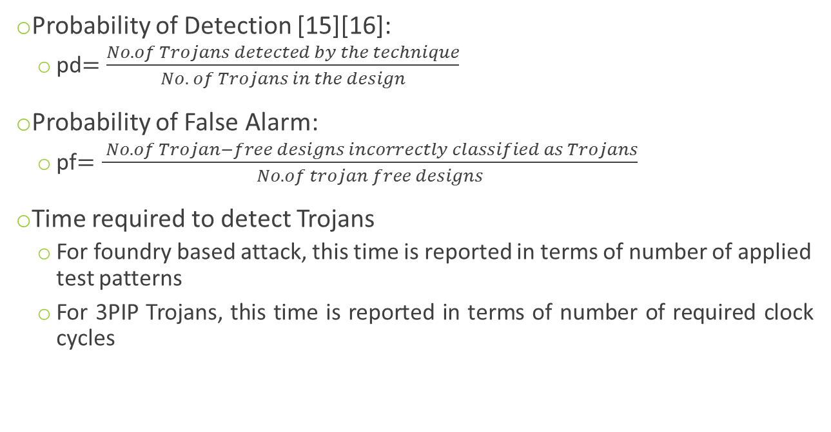
Hardware Trojans - Metrics
Probability of Detection [15][16]:
pd$=\frac{No. of Trojans detected by the technique}{No. of Trojans in the design}$
Probability of False Alarm:
pf$=\frac{ No. of Trojan−free designs incorrectly classified as Trojans}{No. of trojan free designs}$
Time required to detect Trojans
For foundry based attack, this time is reported in terms of number of applied test patterns
For 3PIP Trojans, this time is reported in terms of number of required clock cycles

Slide 14
IP Piracy and IC Overbuilding
An attacker with access to an IP or an IC can steal and claim ownership and/or can overbuild and sell them illegally
Scenario | 3PIP Vendor | SoC Integrator | Foundry | User
1 | O+W+F+M* | Attacker | Untrustworthy Entity | Untrustworthy Entity
2 | O+W+F+M* | Untrustworthy Entity | Attacker | Untrustworthy Entity
3 | Untrustworthy Entity | O+W+F+M* | Attacker | Untrustworthy Entity
Attack Scenarios: O (Obfuscation), W (Watermarking), F (Finger Printing), M (Metering)

Slide 15
IP Piracy and IC Overbuilding - Defenses
5 Methods:
Obfuscation – additional gates like XOR / XNOR, memory elements are inserted also ensuring that the obfuscated circuit will work correctly only if correct values are applied; FSM is obfuscated through replication of states, invalid transitions between states, unused states or black hole states;
Watermarking – designer’s signature is embedded into design artefact; if needed it may be revealed and ownership claimed
Graph partitioning may be done [33]
Finger printing – embedding signature (Public key or Physical Unclonable Functions - PUFs) of the buyer along with water mark of the designer
Metering – set of tools, methodologies and protocols to track a manufactured IC
Split manufacturing – layout of design is split into front-end-of-line (FEOL) and back-end-of-line (BEOL) layers; fabricated separately in foundries and then aligned and integrated using electrical, mechanical or optical alignment techniques

Slide 16
IP Piracy and IC Overbuilding – Defenses
Encode watermark as constraints during graph partitioning
No. of possible watermarks vs. quality of solutions for the graph when the pairs of vertices are merged together (16, 14), (6, 2), (16, 4), (9, 8), (5, 16), (9, 4), (11, 10),
(9, 4).
Graph Partitioning as a solution to Watermarking [33]

Slide 17
IP Piracy and IC Overbuilding – Defenses
Approach 1: Existing states are replicated [46].
Approach 2: State transitions are modified [27], [47]–[49].
Approach 3: Additional states are added [29], [50], [51].
Approach 4: Black-hole states are added [29], [50], [51]. S0 through S6 are the states in the original FSM. All the other states are added for obfuscation. Solid edges are the state transitions in the original FSM.
Obfuscating a controller

Slide 18
Reverse Engineering
Reverse Engineering of an IC involves
Identifying device technology used in it
Extracting its gate-level netlist
Inferring its functionality

Slide 19
Reverse Engineering – Threat Models
Scenario | 3PIP Vendor | SoC Integrator | Foundry | User
1 | O * | Attacker | Untrustworthy Entity | Untrustworthy Entity
2 | O * | Untrustworthy Entity | Attacker | Untrustworthy Entity
3 | Untrustworthy Entity | O * | Attacker | Untrustworthy Entity
4 | O * |  | Untrustworthy Entity | Attacker
5 | Untrustworthy Entity | O * | Untrustworthy Entity | Attacker
6 | Untrustworthy Entity | Untrustworthy Entity | C * | Attacker
7 | O * | Untrustworthy Entity | C * | Attacker
8 | Untrustworthy Entity | O * | C * | Attacker

Slide 20
Reverse Engineering - Defenses
Obfuscation
In scenarios, 1, 2, 4, and 7, 3PIP vendor can obfuscate his IP
Camouflaging
In scenarios 3, 5 and 6, an SoC integrator can obfuscate his design
Trusted foundry can camouflage the layout in scenarios 6 – 8 and add a layer of defense beyond obfuscation
Layouts of standard cells are designed to look alike, resulting in incorrect extraction of netlist
Use of filler cells to confuse the reverse engineer through dummy contacts (manufactured by TSMC)

Slide 21
Side-Channel Attacks
Leakage of secret information through a physical modality when an application is being executed on a system
Attacks are powerful and able to break most existing important cryptographic algorithms
Power consumption, electromagnetic emanations, photonic emissions, acoustic noise are all correlated with the exponent

Slide 22
Side Channel Attacks - Defenses
Leakage Reduction
Introducing dummy multiplication operations
Incurs 33% overhead and eliminates leakage
Noise injection
Inject artificial noise
Key Update
Frequently update the secret key
Side Channel Resistant PUFs
Secure Scan Chains
Side-channel Vulnerability Factor (SVF) gauges the difficulty of finding the secret information from the side channels

Slide 23
Counterfeiting
Counterfeiting is an illegal forgery or imitation of the original component.
Problems:
Original suppliers suffer loss
Poor performance of fake products adversely impacts the overall system performance / reliability
Harms reputation of authentic provider
Potentially tamper the performance of weapons, airplanes, cars or other critical applications

Slide 24
Counterfeiting – Threat Models
Scenario | Design | Test | Recycling / Repackaging | PCB Assembly
1 | Untrustworthy Entity | Attacker | Untrustworthy Entity | Defender
2 | Defender | Untrustworthy Entity | Attacker | Untrustworthy Entity
3 | Untrustworthy Entity | Untrustworthy Entity | Attacker | Defender

Slide 25
Counterfeiting - Defenses
Hardware Metering and Auditing
Set of tools, methodologies and protocols that enable post fabrication tracking of manufactured ICs
IC Fingerprints or PUFs
Device Aging Models / Sensors
IP Watermarking

Slide 26
Security Vulnerability Analysis of Design-for-Test (DfT) Exploits for Asset Protection in SoCs
Analysis of SoC from the vulnerability assessment perspective
Existing information leakage vulnerabilities in implementation of various encryption algorithms and secure microprocessors
Can be exploited to obtain secret keys, control finite state machines, or gain unauthorized access to memory read / write functions

Slide 27
Proposed vulnerability analysis framework [113]

Slide 28
Taxonomy of DFT and security implications

Slide 29
Vulnerability Assessment Framework

Slide 30
Activation Vector Generation
Activation vector generation: (a) Vector ABC = 011 creates the propagation path from a on net Y to R. (b) Vector BD = 01 creates a control path from control point A to asset a on net Z. (b)

Slide 31
Confidentiality and Integrity Analysis
Asset Propagation – Confidentiality Analysis
Asset Control – Integrity Analysis

Slide 32
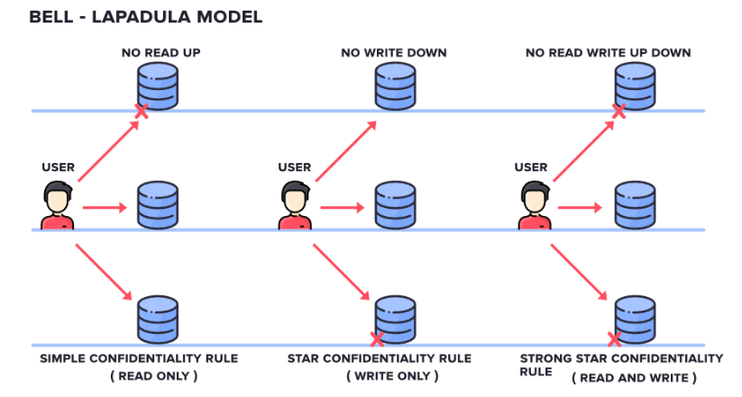
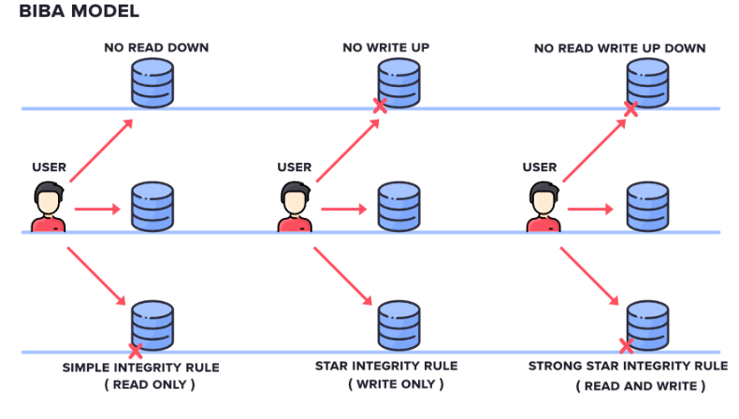
Confidentiality Vs. Integrity Models

Slide 33
Conclusions
Most evaluations of defences are informal and anecdotal
Consistent classification of threat models was not available
Countermeasures can be compared against each other based on the target threat model and corresponding metrics
By performing the proposed analysis, the designer can develop countermeasures to defend against exploits that could become costly if identified after the SoC has been fabricated

Slide 34
Thank You

